Slide 1
Transboundary Conservation Areas
Lesson 4: Transboundary Conservation Governance
Notes:
Photo Credit: Waterton Glacier International Peace Park ©NPS
*Note that all of the photos in this presentation are of Waterton Glacier International Peace Park, Canada and USA.
Context and Purpose of Lesson 4
This Lesson seeks to introduce the learners to transboundary conservation governance and the different structures of shared governance. The purpose is to:
Introduce concepts and general principles of transboundary conservation governance
Describe the nature of transboundary conservation governance as a shared governance type and its defining characteristics
Define and differentiate formal and informal governance structures and discuss the advantages and disadvantages of these structures with respect to transboundary conservation governance.
Supplemental Reading
IUCN WCPA Best Practice Guidelines Transboundary Conservation: A systematic and integrated approach (Pgs. 45–55)
IUCN Guidelines for Protected Areas Legislation (PA Guidelines) (Pgs. 40–46)
IUCN Best Practice Guidelines Governance of Protected Areas: From Understanding to Action (Pgs. 10-29, 32-36)

Slide 2
Factors of Success
Assess the enabling environment to pursue transboundary conservation
Define the transboundary context and relationships affecting the achievement of the conservation targets and the resulting geographic extent
Identify and involve stakeholders, obtain support of decision makers and ensure political will and buy-in
Agree on common values and joint vision
Determine common transboundary management objectives and develop cooperative agreements
Notes:
Photo credit: Nordfriesiche Wattenmeer ©Ralf Roletschek (CC BY-SA 3.0)
Factors of success
Recall the five factors of success in the process of initiating transboundary conservation:
1. Assess the enabling environment to pursue transboundary conservation
2. Define the transboundary context and relationships affecting the achievement of the conservation targets and the resulting geographic extent
3. Identify and involve stakeholders, obtain support of decision makers and ensure political will and buy-in
4. Agree on common values and joint vision
5. Determine common transboundary management objectives and develop cooperative agreements
Lesson 4 addresses key governance concepts, models and approaches that are relevant to all five factors. In particular, understanding governance is key to the third factor, identifying stakeholders and obtaining support of decision-makers. It is also essential for understanding the context and relationships in the second factor. Effective governance is a prerequisite for effective management, and therefore it is key for factors 4 and 5 as well. These factors will be addressed more in Lessons 6 and 7.

Slide 3
Lesson Overview & Goals
Transboundary Conservation Governance
Governance definition and concepts
Characteristics of transboundary conservation governance
Formal and informal approaches in transboundary governance
Implementing transboundary governance in practice
Notes:
Photo Credit: Waterton Glacier International Peace Park ©NPS
Content overview
This Lesson will address:
Definition of governance and key concepts, including components of governance, types of governance and the relationship between governance and management
Characteristics of transboundary conservation governance including key characteristics of effective transboundary governance
Formal and informal approaches in transboundary governance, and the relative merits of different approaches
Notes and suggestions for implementing transboundary governance in practice

Slide 4
Governance Definition and Concepts
What is governance? What does it involve?
  …
Notes:
Photo Credit: Waterton Glacier International Peace Park ©NPS
Discussion
Use this slide to start a discussion. Ask learners:
What is governance? What do you think of when you hear the word governance?
What does governance involve? What are the components, processes or activities?
Pause the slideshow and take notes on the slide itself to record learner’s responses. Duplicate the slide if you need more space. Afterwards, responses can be shared with learners.

Slide 5
Governance Definition and Concepts
“Governance is the interactions among structures, process and traditions that determine how power and responsibilities are exercised, how decisions are taken, and how citizens or other stakeholders have their say.”
Understanding Governance
Dimensions of Governance
Who makes decisions?
How are decisions made?
How is authority held or shared?
Who is accountable for decisions, and how?
Governance Quality
Governance Diversity
Governance Vitality
Notes:
Photo Credit: Waterton Glacier International Peace Park ©NPS
Governance definition and concepts
Check learner’s responses from the discussion against the ideas in this slide.
What is governance?
“Governance is the interactions among structures, process and traditions that determine how power and responsibilities are exercised, how decisions are taken, and how citizens and other stakeholders have their say.” (Graham et al. 2003 Governance Principles for Protected Areas in the 21st Century. A Discussion Paper).
Understanding Governance
Ultimately, governance is about authority and procedures for decision-making. Governance answers the questions:
Who makes decisions?
How are decisions made?
How is authority held or shared?
Who is accountable for decisions, and how?
Dimensions of Governance
We can talk of governance in the context of protected areas in two broad senses:
Good governance - dealing with the quality of governance.
Types of governance - dealing with who exercises authority and how, or governance diversity.
An additional dimension of governance is now being discussed:
Governance vitality – extent to which decision-makers are responsive and functional, wise, adaptable, creative and responsible.

Slide 6
Governance versus Management
Governance is about process:
Who takes decisions
Management is about substance: How decisions are implemented
Who brings people together?
Who decides what the objectives are?
Who decides how differences are resolved?
How are decisions taken?
Who ensures the resources and conditions for effective implementation?
Who holds the power and responsibility?
Who is held accountable?
What is done in pursuit of given objectives?
What are the means and actions to achieve objectives?
How is effectiveness generated and ensured?
Notes:
Governance versus management
Governance and management are often confused.
Governance is about process: Who takes decisions
Who brings together people to determine what ought to happen?
Who decides what the objectives are and how differences are reconciled?
How are decisions taken?
Who ensure the resources and conditions for effective implementation?
Who holds power, authority and responsibility?
Who is held accountable?
Management is about substance: How decisions are implemented
What is done in pursuit of given objectives? (i.e. What is done to implement decisions taken to meet the objectives?)
What are the means and actions to achieve objectives?
How is effectiveness generated and ensured?
*Notes:
Clear governance structures are essential to effective management
Governance systems provide clarity on who can take decisions that will be implemented through management
In the transboundary context, cooperation can begin at the management level, but effective cooperative management depends on authority and legitimacy provided by transboundary governance
If there is already clarity in the group about the concept of governance, this slide can be omitted.

Slide 7
Types of Governance
Type A. Governance by Government
  Federal or national ministry or agency in charge
  Sub-national ministry or agency in charge (e.g. regional, provincial, municipal
  level)
  Government-delegated management (e.g. to an NGO)
Type B. Shared Governance
  Transboundary governance (formal and informal arrangements between two
  or more countries)
  Collaborative governance (diverse actors and institutions work together)
  Joint governance (pluralist board or other multi-party governing body)
Type C. Private Governance
  Conserved areas established and run by:
  Individual landowners
  Non-profit organizations (e.g. NGOs, universities)
  For-profit organizations (e.g. corporate owners, cooperatives)
Type D. Governance by Indigenous Peoples and Local Communities
  Indigenous Peoples’ conserved territories and areas
  Community conserved areas and territories
Notes:
Types of governance
IUCN defines four types of governance in the context of protected areas. The IUCN Governance Types first appeared in the IUCN Guidelines for Applying Protected Area Management Categories (2008). Modifications related to understanding of transboundary governance were done in the IUCN WCPA Best Practice Guidelines in 2015.
Type A. Governance by government
Federal or national ministry or agency in charge
Sub-national ministry or agency in charge (e.g. at regional, provincial, municipal level)
Government-delegated management (e.g. to an NGO)
Type B. Shared Governance
Transboundary governance (formal and informal arrangements between two or more countries)
Collaborative governance (through various ways in which diverse actors and institutions work together)
Joint governance (pluralist board or other multi-party governing body)
Type C. Private governance
Conserved areas established and run by:
Individual landowners
Non-profit organizations (e.g. NGOs, universities)
For-profit organizations (e.g. corporate owners, cooperatives)
Type D. Governance by Indigenous Peoples and local communities
Indigenous Peoples’ conserved territories and areas – established and run by Indigenous Peoples
Community conserved areas and territories – established and run by local communities
Discussion
Ask learners:
What types of governance are you familiar with in your experience?
What types of governance are found in Transboundary Conservation Areas (TBCAs)?
*Note:
These governance types are not hierarchical – different governance types are appropriate to different situations depending on institutions, land tenure and stakeholder rights, interests and involvement
There can be different governance types in the same area
TBCAs always involve a form of shared governance between two or more countries
TBCAs can also involve areas governed by Indigenous Peoples and local communities or private landowners or organizations
In some cases, governance types can change over time, e.g., through transfer of ownership or governance authority to indigenous or private groups, or vice versa.
This slide may be printed and distributed as a handout.

Slide 8
Governance Facets and Levels
International
Regional
Civil Society
Community
Government
Private
National
Local
Notes:
Governance facets and levels
There are different facets and levels of governance.
Governance exists at international, regional, national and local levels
Governance can involve private, community, civil society and government actors at each of these levels at varying degrees.
*Note: this diagram is a drastic simplification of the complex, multi-level, multi-sector, multi-actor governance complex relating to transboundary conservation.

Slide 9
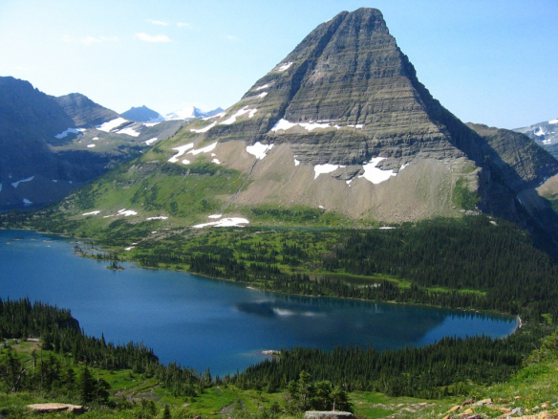
Transboundary Conservation Governance
Shared Governance: concerns the sharing of power, authority and responsibility between various actors in the process of making relevant decisions
Transboundary Governance
Form of Shared Governance
Involves actors from two or more countries
Includes formal or informal arrangements and initiatives between multiple actors
Utilizes multiple levels of authority
Notes:
Photo Credit: Waterton Glacier International Peace Park, Hidden Lake ©NPS
Transboundary conservation governance
Transboundary governance is a type of shared governance.
Shared governance describes the sharing of power, authority and responsibility between various actors in the process of making relevant decisions.
Transboundary conservation governance is one type of shared governance arrangement for TCBAs.
Involves actors from two or more countries
Includes formal and/or informal arrangements between multiple actors
Utilizes multiple levels of authority from local level, through the district or provincial level, to the level of the national ministry or even to a supra-national regional level.

Slide 10
Characteristics of Transboundary Governance
What makes transboundary governance special? What are the key characteristics?
  …
Notes:
Photo Credit: Waterton Glacier International Peace Park ©Maja Vasilijević
This slide provides another opportunity for discussion before going on to present characteristics of transboundary governance. It may be useful where participants have some experience with transboundary governance and would benefit from sharing ideas.
Discussion
Use this slide to start a discussion. Ask learners:
What is special about transboundary governance?
What are the key characteristics of transboundary governance? What is necessary to make transboundary governance a success?
Pause the slideshow and take notes on the slide itself to record learner’s responses. Duplicate the slide if you need more space. Afterwards, responses can be shared with learners.

Slide 11
Governance Implications of TBCAs
TBCA Characteristics
Governance Implications
Complex socio-environmental systems
Multiple approaches to land use and
land tenure
Many actors working at many levels
Range of governance arrangements
Cooperative management
Conflict management/resolution
Participation of multiple actors
Institutional and financial coordination
Flexibility and adaptation
Notes:
Photo Credit: Waterton Glacier International Peace Park ©Maja Vasilijević
Governance implications of TBCAs
To understand TBCA governance, start by understanding what are the characteristics of TBCAs with special implications for governance. This slide introduces characteristics of TBCAs with governance implications. The next slide describes characteristics for TBCA governance.
Principal characteristics of TBCAs with governance implications:
TBCAs are complex socio-environmental systems
They may include multiple approaches to land use and land tenure
There can be many actors working at many levels
Within a TBCA there can be a range of different types of governance arrangements.
These characteristics have implications for transboundary conservation governance. Governance structures will need to be able to:
Ensure cooperative management, involving multiple sectors, users and actors across levels
Provide mechanisms for managing and resolving conflicts
Enable participation of multiple actors
Ensure institutional and financial coordination across sectors and levels
Adapt to changing circumstances – there is often a process from informal to more formalized governance over time.

Slide 12
Characteristics of Effective Transboundary Conservation Governance
Leadership
Representation
Public Participation
Function
Scope
Authority, Legitimacy and Accountability
Learning
Decision-Making
Conflict Resolution
Financing
Adaptive Management
Notes:
Photo Credit: Waterton Glacier International Peace Park (Canada and United States) ©Maja Vasilijević (top); Cameron Lake in Waterton Lakes National Park (Alberta, Canada) ©Michael Rogers (bottom)
Characteristics of effective transboundary conservation governance
There is no single model of transboundary conservation governance. However, multiple characteristics have been identified that exist in successful transboundary conservation governance arrangements.
Leadership: This requires willingness to share authority, forge alliances with people holding different interests and viewpoints towards a common conservation goal. It requires different types of leaders to enable and sustain action.
Representation: The identification of relevant stakeholders and their participatory roles in the governance process. This also concerns the balance of power within the area.
Public participation: Strategies to involve government agencies, local communities, private landowners, NGOs, Indigenous Peoples, rightsholders and other stakeholders.
Function and scope: The role and geographic area of interest and its relationship to other social and political entities within the region.
Authority, legitimacy and accountability: Determining the degree of legal authority, alignment of public and political aims, and the level of formal or informal organization (formal and informal recognition; linking informal arrangements to formal decision-making systems).
Learning: The process of collecting, analyzing and facilitating scientific and public learning, the recognition and application of Indigenous and traditional knowledge.
Decision-making: The type of decision rules, roles and responsibilities of representatives and the nature of decisions as mandatory of voluntary.
Conflict resolution: This includes procedures to prevent, manage and resolve conflicts.
Adaptive management: Developing strategies to monitor and measure progress, support ongoing learning and adapt to change.
Financing: Establishing sustainable financial support form the public, private or NGO sources and securing other income generating streams from the value of the natural resource base that can be used to sustain transboundary conservation.

Slide 13
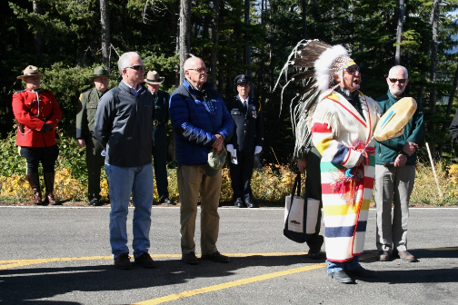
Models of Transboundary Governance
System
Can include formal and informal practices and arrangements or come combination thereof
Actors
Bringing together actors requires collaborative structures and includes involvement by various stakeholders
Structures
New structures or institutions should address gaps in governance and involve all relevant stakeholders
Governance arrangements often become more formal over time
Notes:
Photo Credit: Waterton Glacier International Peace Park ©Maja Vasilijević
Models of transboundary governance
The model of transboundary governance should reflect the needs of the area concerned.
The optimum governance model will involve making choices around the degree of formality, the actors and structures involved, the need to establish new governance structures and the need for structures to evolve and adapt over time.
A governance system can include both formal and informal governance practices and arrangements. Often, the use of both types results in a more comprehensive and competent governance structure.
Actors involved: Bringing the actors together requires collaborative structures, such as partnerships, networks, commissions, groups, alliances or specially established institutions with members from each participating country. The various actors may include governments, government agencies, NGOs, local communities, Indigenous Peoples and protected area administrations.
Creation of New Structures: Creating new structures or institutions is needed where there is a gap in governance that requires increased integration and coordination of established interests.
The following slides provide more detail on strengths and weaknesses of formal and informal models of governance, respectively.
*Note:
It is important to remember that “formal” versus “informal” categories of governance represent a spectrum – in reality, different governance structures may be more or less formal, and most involve a mixture.
In general, governance arrangements often become more formalized over time. Structures evolve and adapt.

Slide 14
Formal Transboundary Governance
Based on legal mechanisms or instruments which may be binding or non-binding
Strengths
Weaknesses
Creates forums for thinking and action
Allows agencies to work across borders
Enables high level / broad based support
Provides flexibility to include all sectors
Clarifies roles and responsibilities
Creates incentives/binding obligations
Provides legitimacy
May address long-term concerns
Provides a platform for diverse interests
May help build trust and social capital
Authority limited to planning and not implementation
Staff turnover may disrupt participation
Difficulties in distributing costs and benefits
Requires trust and social capital
Prioritization of projects may be difficult
Agreement on high level vision may not mean agreement on how to get there
May involve start-up and maintenance costs for new structures
Notes:
Formal governance
Formal governance is based on a foundation of legal principles that may be binding or non-binding.
This slide provides an overview of strenghts and weaknesses of more formal tranboundary governance arrangements. It may be distributed to learners as a handout.
Strengths:
Creates more or less permanent forums to facilitate transboundary thinking and action
Allows governmental agencies to work across borders either within existing government structures or by realigning functions
Enables high level and broad based support for implementation
Provides flexibility to include representatives from all sectors (public, private, non-profit, academia, etc.)
Clarifies roles and responsibilities, minimizing misunderstanding and friction among participants
May ensure implementation by creating the right incentives and binding obligations
Provides legitimacy for addressing transboundary issues
May be better able to address long-term concerns
Provides a central platform to integrate diverse needs and interests, in the case of establishment of new formal structures
May help build trust and social capital
Weaknesses:
Authority may be limited to planning and visioning and not implementation
Effectiveness depends on good faith efforts and continuity of participation among individuals in agencies; staff turnover can derail group efforts
Equitable distribution of costs and benefits among participants can be challenging
Requires trust and the building of social capital
Prioritizaion of projects may be difficult as some individual partners may want their interests to predominate, despite agreement on transboundary vision
May include agreement on high-level vision but very different conceptualizations on what this means and how to get there
Newly established institutions often have high start-up and maintenance costs and may not be easily adapted to changing circumstances

Slide 15
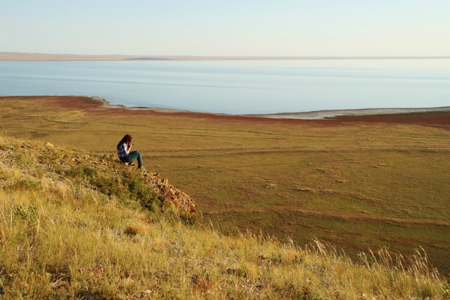
China-Mongolia-Russia Dauria International Protected Area: Formal Transboundary Governance
High-level formal governance: Joint Commission for the China-Mongolia-Russia Dauria International Protected Area, established in 1994
Commitment of the parties to support mass ungulate migrations
Joint Commission approves the Working Groups’ plans and supports their work financially
Efficient cooperation in scientific research, species monitoring and environmental education
Notes:
Photo Credit: Zun Torey Lake (Russia) in Dauria Landscapes ©Maja Vasilijević
China-Mongolia-Russia Dauria International Protected Area: Formal transboundary governance
China-Mongolia-Russia Dauria International Protected Area (CMR DIPA) is an example of formal transboundary conservation governance. In 1994, an agreement was signed in Ulaanbaatar to establish a TBCA comprising of the Daursky State Nature Biosphere Reserve and the Valley of Dzeren Federal Nature Refuge in Russia, Mongol Daguur Special Protected Area in Mongolia, and Lake Dalainor Nature Reserve in China. Simultaneously, the supreme governing body was established, the Joint Commission for the CMR DIPA. It is a high-level formal structure established to oversee the trilateral CMR DIPA.
Considering the site supports mass migrations of the Mongolian Gazelle, one of the key points of the trilateral agreement was the commitment of the parties to provide for unrestricted movement of wild animals within the reserve.
The Joint Commission meets occasionally (not on a yearly basis though), while the Working Groups comprised of staff of protected areas meet once or twice every year. The Joint Commission helps out with international projects, approves Working Groups’ plans and supports their work financially. Since 1994, the protected areas of DIPA have organised more than 100 scientific research expeditions and produced several joint scientific publications. They have organised children competitions for drawings on the theme of ecology and organised summer camps for the winners, held trainings and joint seminars, promoted DIPA through organisation of a 20th anniversary of DIPA held in Mongolia, and established an international biological station in Russia (Utochi). More than 200 monitoring stations were established to study e.g. habitat dynamics related to climate change; water outflow of the Uldz River and changes in water levels of the lakes; and steppe dynamics.
Supplemental reading:
For more information on the Landscapes of Dauria World Heritage Site (not including Chinese part of a transboundary site), please check the documents at https://whc.unesco.org/en/list/1448/documents/

Slide 16
Informal Transboundary Governance
Does not require ratification of official agreements; based on “soft” arrangements
Strengths
Weaknesses
Requires less time, money, resources
Well suited to respond to problems
Minimizes bureaucratic hurdles
Can build on existing relationships
Can be tailored to the specific scale, needs, interests and solutions
Provides platform for diverse interests
Requires trust
Provides flexibility to include all sectors
May be difficult to sustain
Potential for misunderstanding
Difficult to resolve disputes
Susceptible to changes in power, politics, personnel and resources
Difficulties in distributing costs and benefits
Transaction and coordination costs
Tools and resources may disappear when pressing issue goes away
Start-up and maintenance costs
Notes:
Informal transboundary governance
Informal transboundary governance:
Characteristics: Does not require ratification of official agreements. Based on looser arrangement made between participants.
Strengths:
Requires less time, money and other resources than formal arrangements
Well suited to respond to problems characterize by divergent sources, actors and information
Minimizes administrative and bureaucratic hurdles
Can be built on existing relationships
Can be tailored to the specific scale, needs, interests and solutions
Platform to integrate diverse needs and interests (in case of establishment of new transboundary informal structures)
Requires trust
Provides flexibility to include representatives from all sectors (public, private, non-profit, academia, etc.)
Weaknesses:
May be difficult to sustain due to lack of formal structure
Lack of specific agreement on roles and responsibilities can lead to misunderstanding and friction through the loss of continuity and/or champions with institutional memory
Lack of dispute resolution processes may make relationships difficult to maintain
Highly susceptible to changes in power, politics, personnel and resources
Equitable distribution of costs and benefits among participants can be challenging
May lead to an increase in transaction and coordination costs
Tools and resources may disappear when the issue that spurred informal cooperation goes away
Newly established informal structures/institutions often have high start-up and maintenance costs

Slide 17
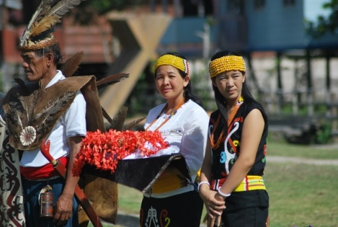
FORMADAT in the Highlands of Borneo: Informal Transboundary Governance
Located in the interior of Borneo (Indonesia, Malaysia)
Common linguistic and cultural heritage of local communities
Alliance of the Indigenous Peoples of the Highlands (FORMADAT) established in 2004: aimed to forge stronger links across the border to help steer development in sustainable directions
Grass-root initiative – a sense of local ownership
Notes:
Photo Credit: Lundayeh Indigenous Peoples in the Highlands of the Heart of Borneo ©FORMADAT (Taken from IUCN BPG, 2015, pp. 33)
FORMADAT in the Highlands of Borneo: Informal transboundary governance
The Highlands of Borneo form part of a larger transboundary conservation initiative called the Heart of Borneo and the Highlands are shared by Indonesia and Malaysia (the Heart of Borneo also includes Brunei). It is a relatively isolated area and one of the largest forested and traditionally farmed catchment areas in Borneo. The Highlands are inside the Indonesian Kayan Mentarang National Park and the Malaysian Pulong Tau National Park.
The Lundayeh/Lun Bawang, Kelabit, and Sa’ban peoples of the transboundary Highlands share a common linguistic and cultural heritage. The strong ethnic and family ties are one of the main reasons for the close social and economic/trade interactions that take place across the international border. In 2004, the people of the Highlands established FORMADAT, an Alliance of the Indigenous Peoples of the Highlands. FORMADAT is an alliance of transboundary nature that has resulted with the enhanced conservation and cooperation between the concerned countries. The principal aim of FORMADAT was to forge stronger linkages across the border to diminish uncontrolled development.
Though informal in nature, FORMADAT is supported by a non-legally binding Declaration signed by its members in 2006. The Declaration addresses the social, economic and environmental pillars of sustainability. FORMADAT is a valuable example of a grass-root initiative, arising from the local peoples’ commitment on both sides of the international border to secure sustainable development and conserve the natural resources. In transboundary conservation, such local constituencies are critical in generating the sense of local ownership necessary for the success of regional conservation efforts. In 2013, representatives of FORMADAT Indonesia and Malaysia were invited as observers to the trilateral government meeting of the Heart of Borneo initiative for the first time.
Supplemental reading:
Eghenter, C. (2015). Case study 4: Engaging communities across the border: FORMADAT in the Highlands of the Heart of Borneo. In: Vasilijević, M., Zunckel, K., McKinney, M., Erg, B., Schoon, M., Rosen Michel, T. Transboundary Conservation: A systematic and integrated approach. Best Practice Protected Area Guidelines Series No. 23, Gland, Switzerland: IUCN.

Slide 18
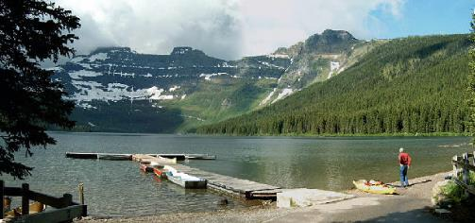
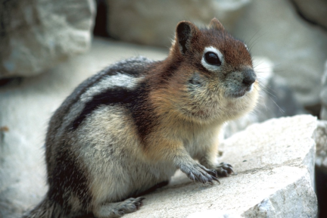
Implementing Transboundary Conservation Governance in Practice
Collaboration is the cornerstone of effective TB governance. This requires engagement of stakeholders such as communities, rightsholders, the private sector, experts and governments from all countries involved in a Transboundary Conservation Area.
Key: various interests should not only be consulted but enabled to engage directly in decision-making
TB governance is increasingly “nested”: it includes independent but linked systems of governance at various levels of social organization.
TB governance is adaptive, that is flexible enough to respond to social, economic and environmental variables.
Notes:
Photo Credit: Cameron Lake in Waterton Lakes National Park (Alberta, Canada) ©Michael Rogers (top); Waterton Glacier International Peace Park, Golden Mantled Squirrel ©NPS (bottom)
Implementing transboundary conservation governance in practice
Collaboration is the cornerstone to effective governance. This requires engagement of stakeholders such as the community, rights holders, the private sector, experts and governments from all countries involved in a TBCA. A core principle is that various interests should not only be consulted but enabled to engage directly in decision-making.
Governance should be “nested” meaning that it should include independent but linked systems of governance at various levels of social organization.
A system of governance must be adaptive that is flexible enough to respond to social, economic, and environmental variables. Learn by doing and create an expectation of learning as we go.

Slide 19
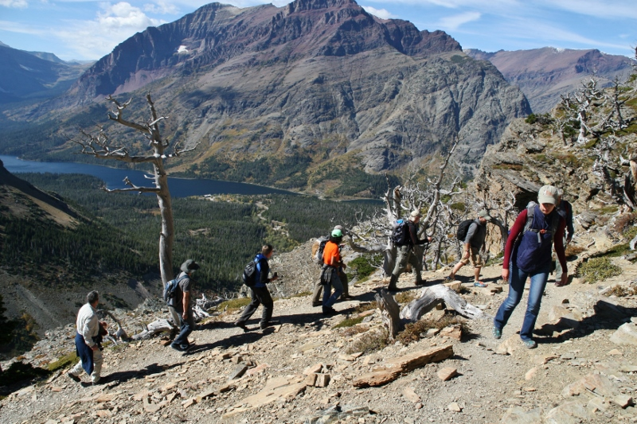
Implementing Transboundary Conservation Governance in Practice
Best Practice Suggestions
Address common elements of good governance
Let function dictate structure
Promote flexibility and adaptability
Design mechanisms for accountability
Govern at the scale of the problem
Weigh costs and benefits
Notes:
Photo Credit: Waterton Glacier International Peace Park ©Maja Vasilijević
Implementing transboundary conservation governance in practice
Best Practice Suggestions for Governance
Address common elements of good governance: Although there is no single model for transboundary governance, there are common elements that should be addressed in the design of any governance arrangement.
Let function dictate structure, no matter wheter the transboundary initiative is formal or informal.
Promote flexibility and adaptability, due to constant changes in social, political, economic and environmental conditions.
Design mechanisms for accountability, supporting open, transparent, inclusive and informed process.
Govern at the scale of the problem. In transboundary conservation, some issues are better addressed at a very local scale while others wll need to span large regions.
Weigh costs of setting up and implementing shared governance structures against the benfits gained. This question of whether the benefits of transboundary cooperation outweigh the costs recurs throughout this module.

Slide 20
Discussion
What is your experience with protected area governance?
What is different in TBCAs?
  …
Notes:
Photo Credit: Waterton Glacier International Peace Park ©NPS
Discussion
Use this slide to start a discussion.
Ask learners about their experience with governance.
What is your experience with governance in protected areas?
What is different in TBCAs?
Pause the slideshow and take notes on the slide itself to record learner’s responses. Duplicate the slide if you need more space. Afterwards, responses can be shared with learners.
Questions and answers
Following the discussion, ask learners if they have any questions on the lesson, or on anything the other learners have said.

Slide 21
Transboundary Conservation Areas
End of Lesson 4
Notes:
Photo Credit: Waterton Glacier International Peace Park ©NPS

